Slide 1
Cloud Cost Optimizer

Slide 2

Problem Statement : Cloud Cost Optimization
User has some requirements according to the traffic appearing on cloud
The cost must be optimal in each possible situation based on the proportion between traffic and resources being used.

Slide 3
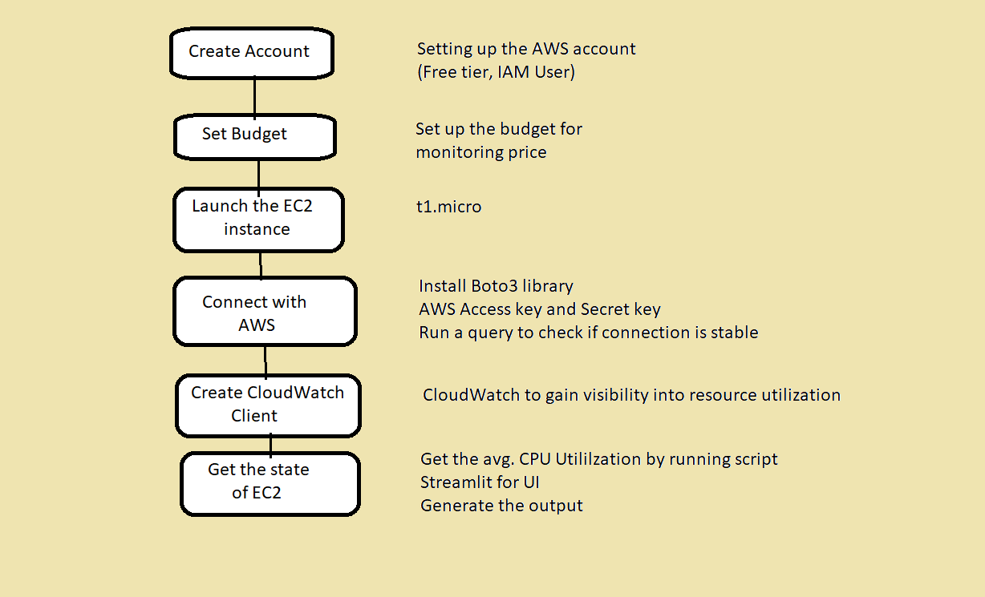
Data flow

Slide 4
Benefits and Business Values
Reduces Costs
Evaluate
Storage
Evaluate and right-size
Your resources
Optimizing storage and
subscription
Stick to budget
Align your budget to
Your goals
Helps functional leaders
Maximize cost savings
Obtaining the best pricing and term for
All business purchases. Standardizing,
Simplifying and rationalizing process
And services.

Slide 5
1. Tanmoy Malakar 2. Shivas Bhat 3. Surajj Jhawar 4. Drushtant Doshi 5. Hrishikesh Bunge 6. Rutuja Shah 7. Vaibhav Adke

Slide 6
Q/A Session

